Slide 1
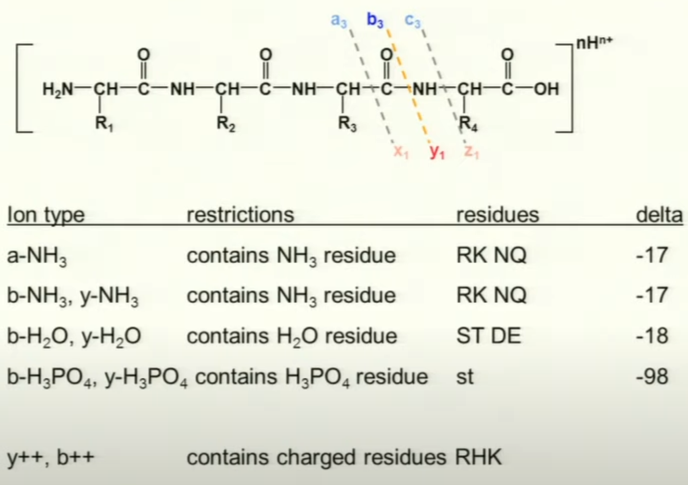
Sequence Specific Fragment Ion Types

Slide 2
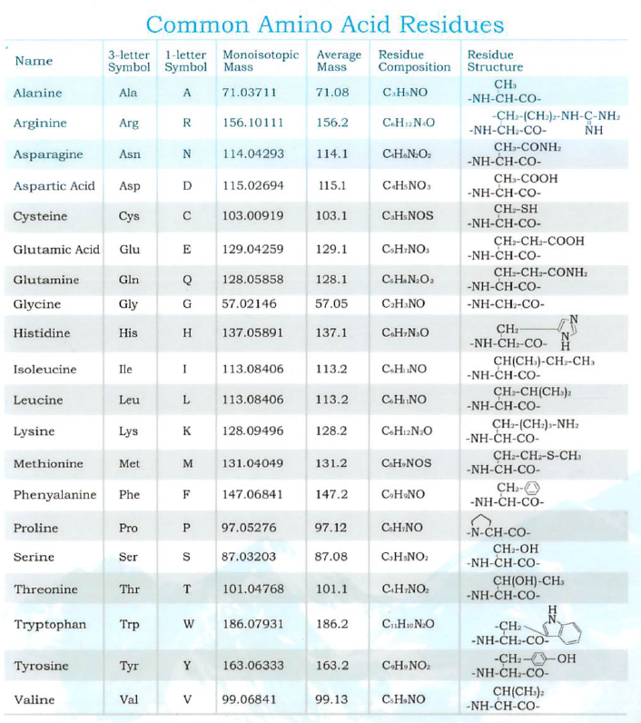

Slide 3
S Q H L F A P I S E K
Notes:
How do we derive a peptide sequence from it’s MS/MS spectrum. Predominantly amino acids are fragmented at amide bonds and because amino acids have different side chains we can the amino acid sequence from the difference in mass in adjacent fragments.

Slide 4
88
216
353
467
614
685
782
895
982
1111
S Q H L F A P I S E K
1170
1042
905
792
645
574
477
363
276
147
1042 / 2
792
M-NH₃
905
574
644
467
685
1042
353
895
1111
982
Notes:
When you look at all the spectra data together you can deduce the sequence of this peptide ion. You can see in red the masses of the peptides fragmented between the Leu and Phe residues.

Slide 5
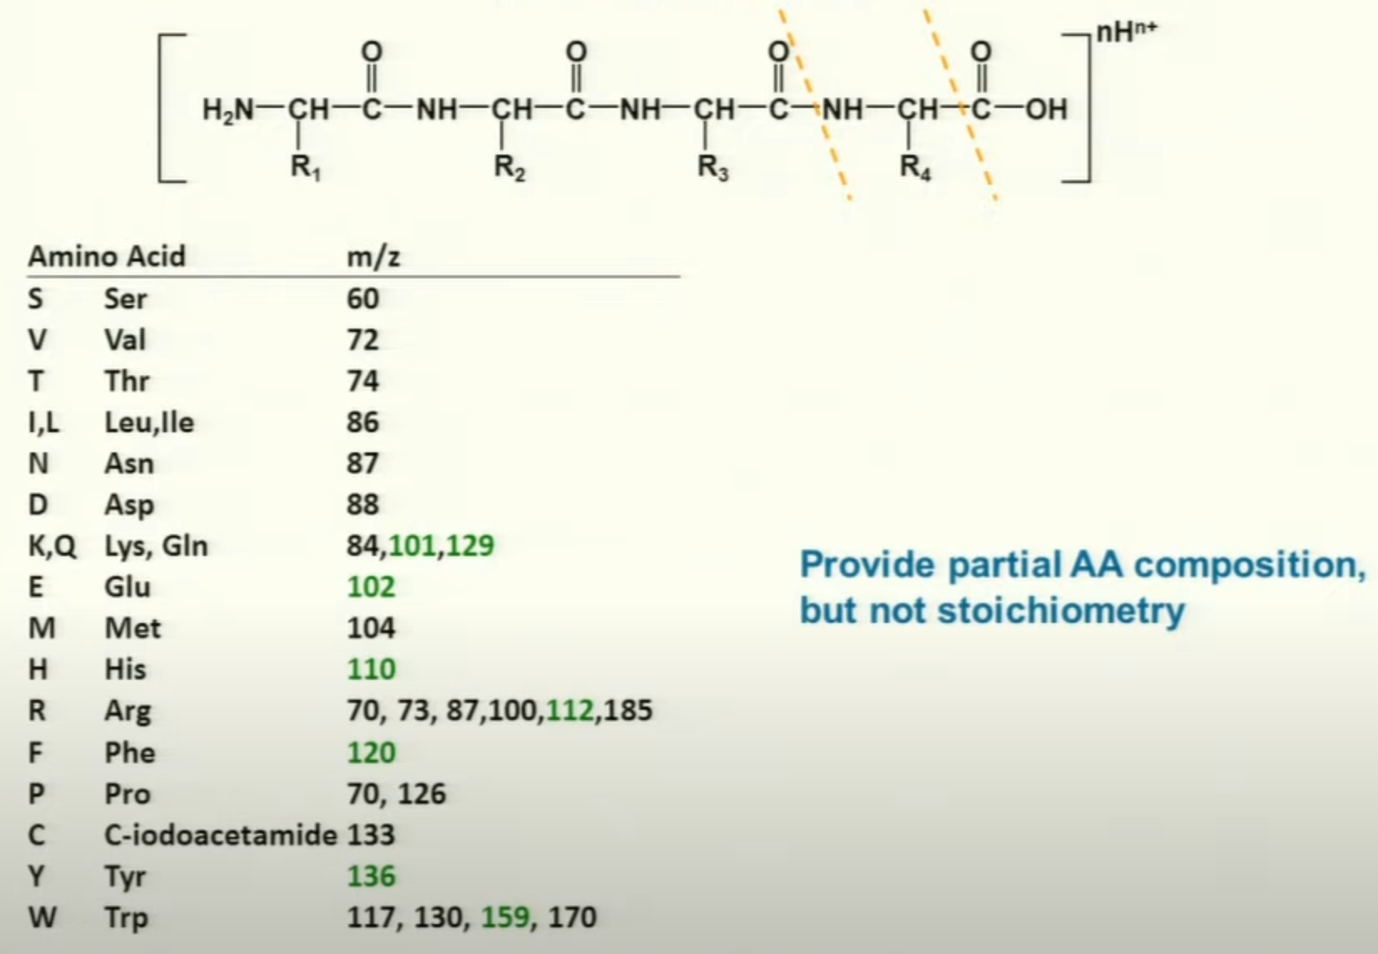
Immonium Ions

Slide 6
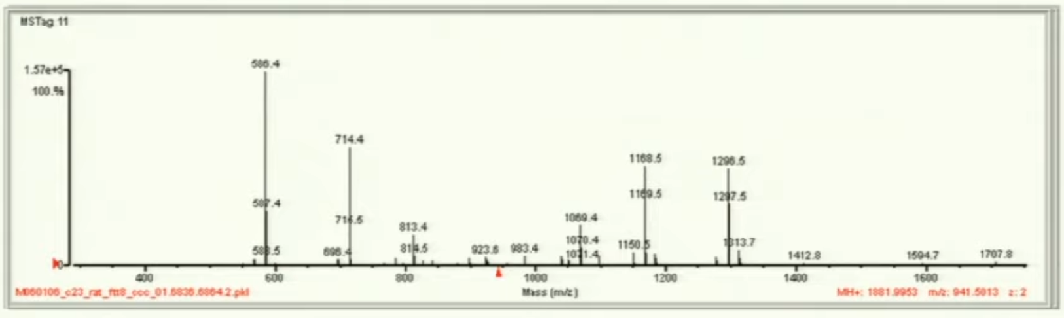
B and Y ions provide complementary information
MH+ = 1881.9953

Slide 7
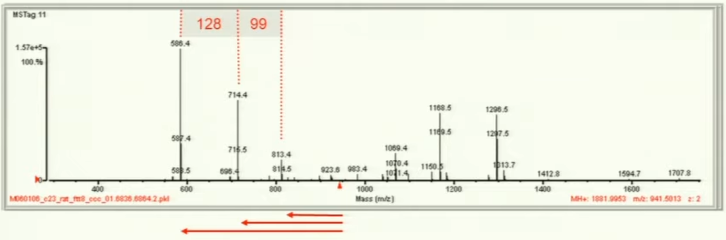
B and Y ions provide complementary information
MH+ = 1881.9953

Slide 8
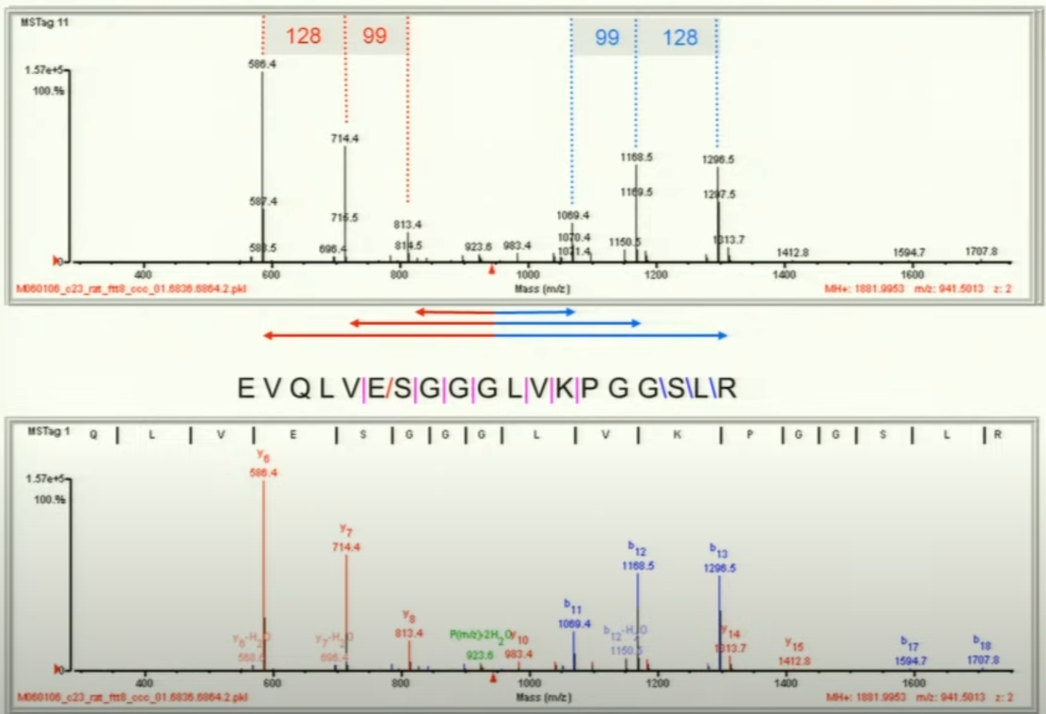
B and Y ions provide complementary information
MH+ = 1881.9953

Slide 9
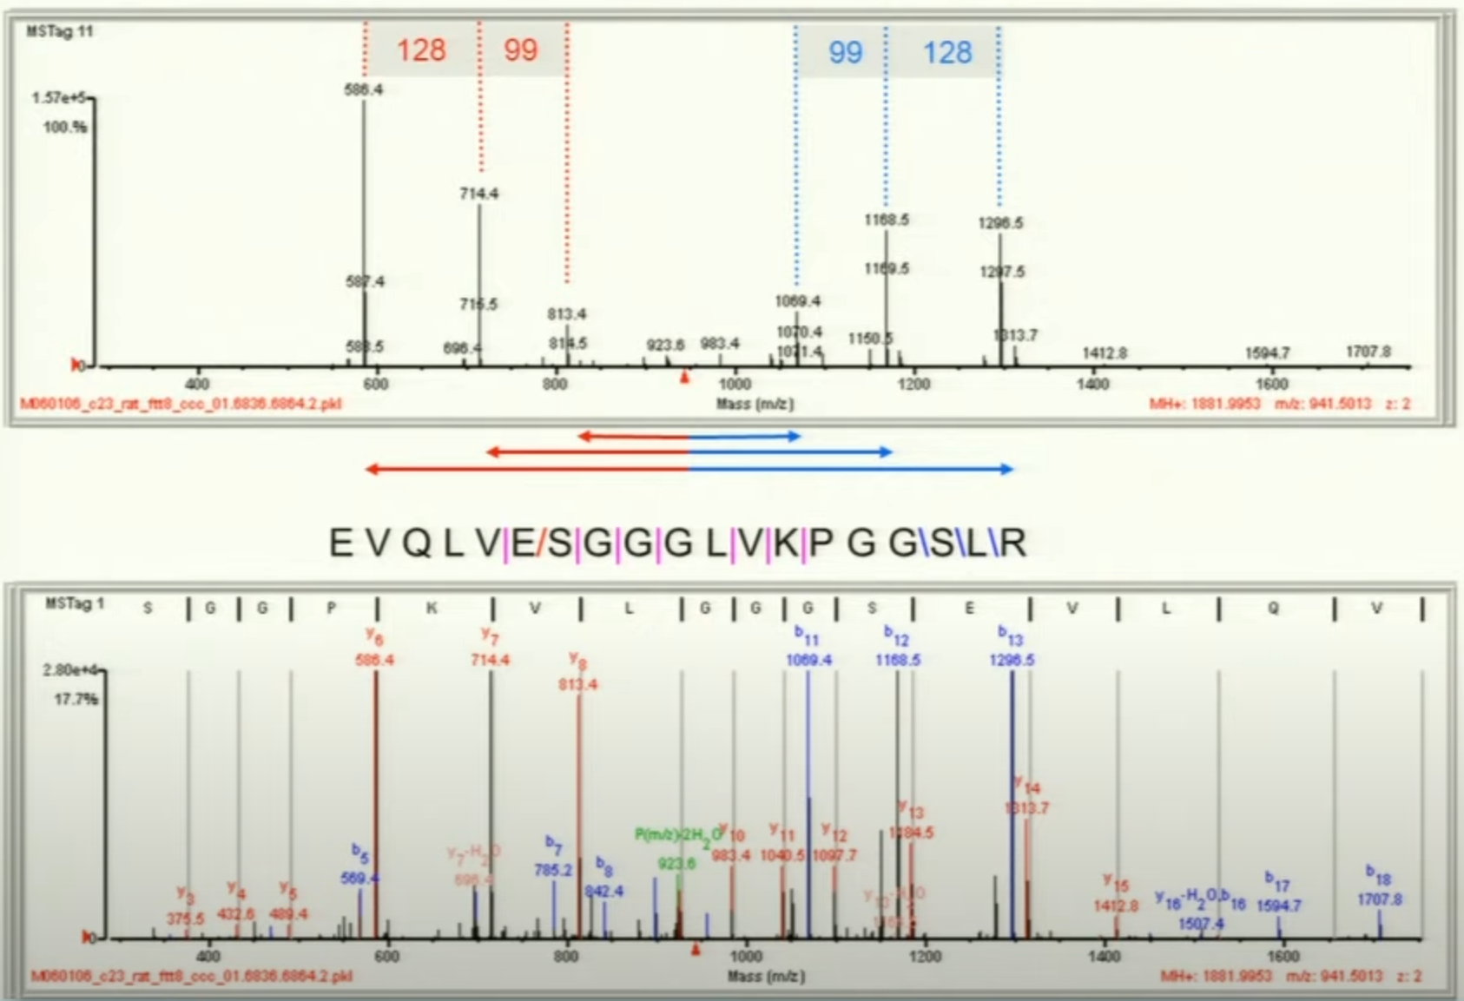
B and Y ions provide complementary information

Slide 10
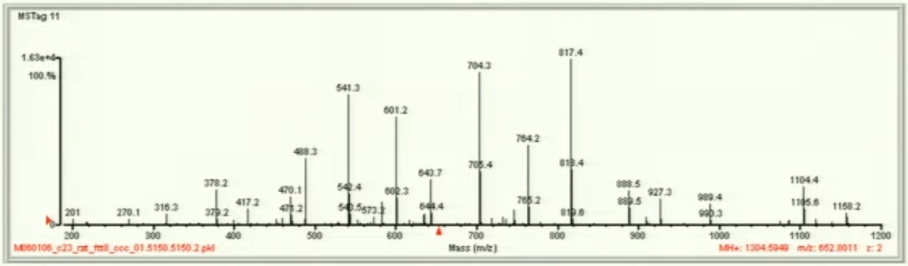
Another Example

Slide 11
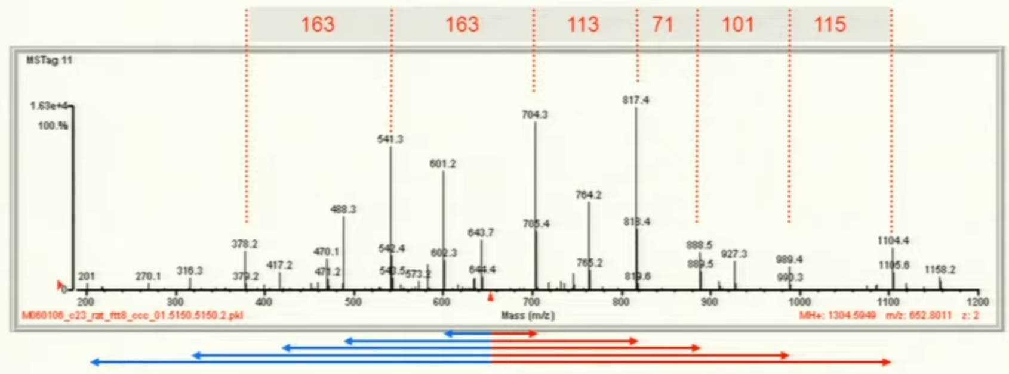
Another Example

Slide 12
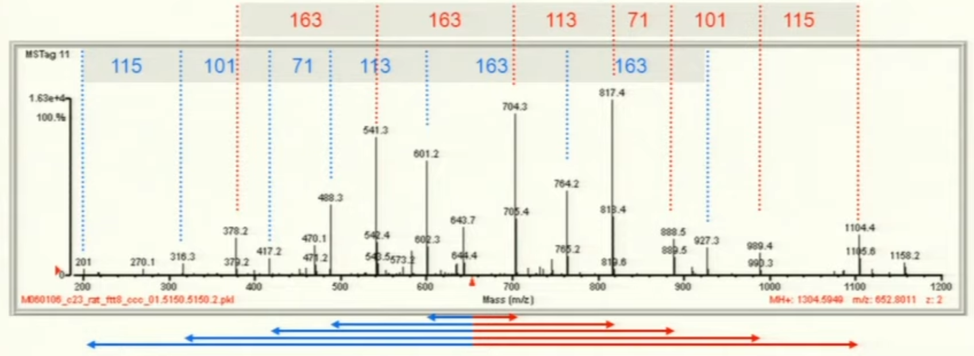
Another Example

Slide 13
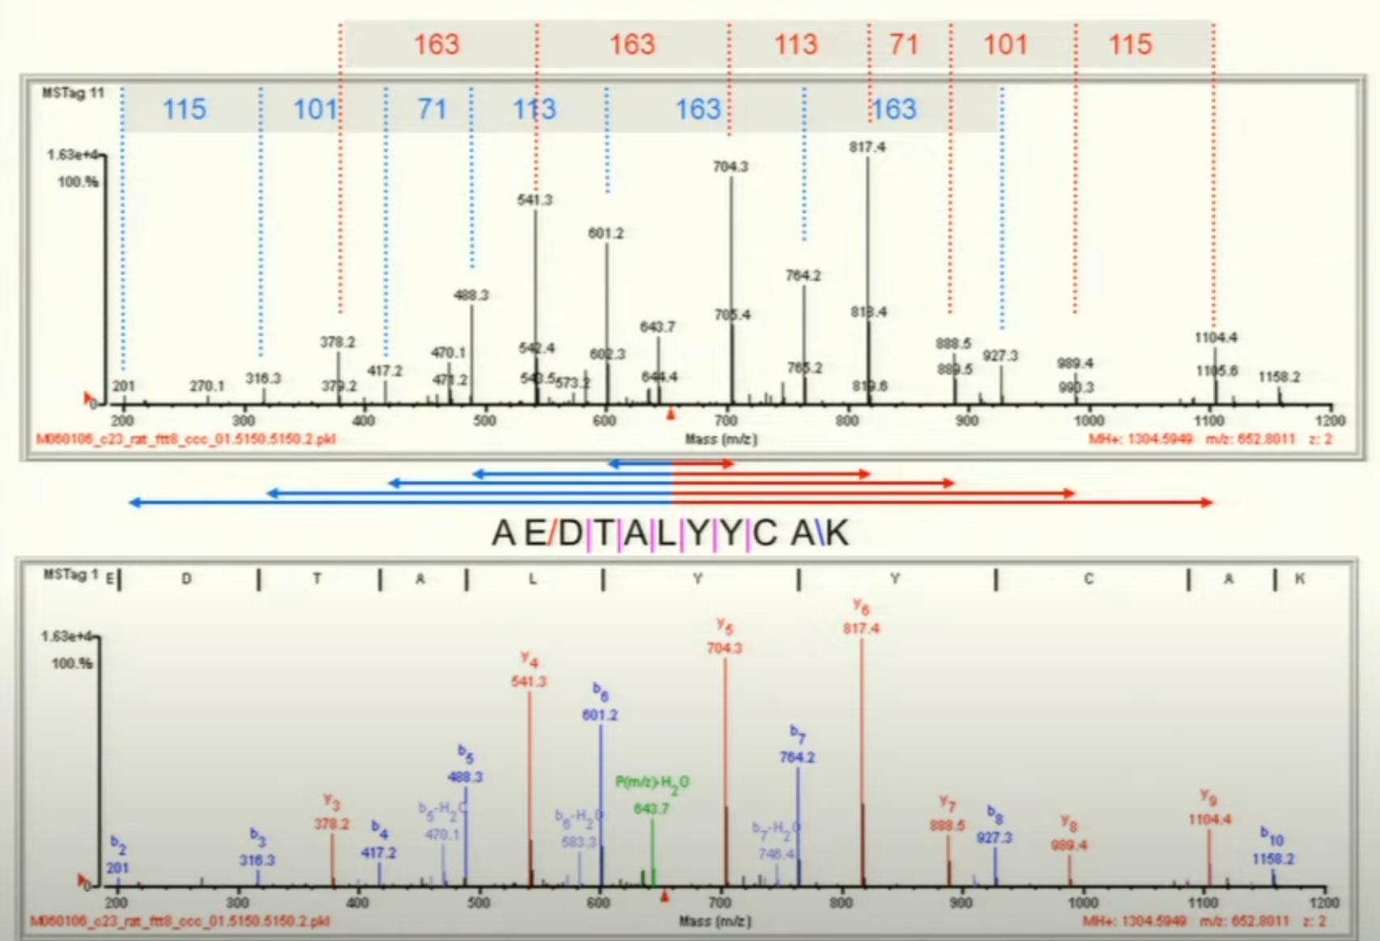
B and Y ions provide complementary information

Slide 14
B and Y ions provide complementary information

Slide 15
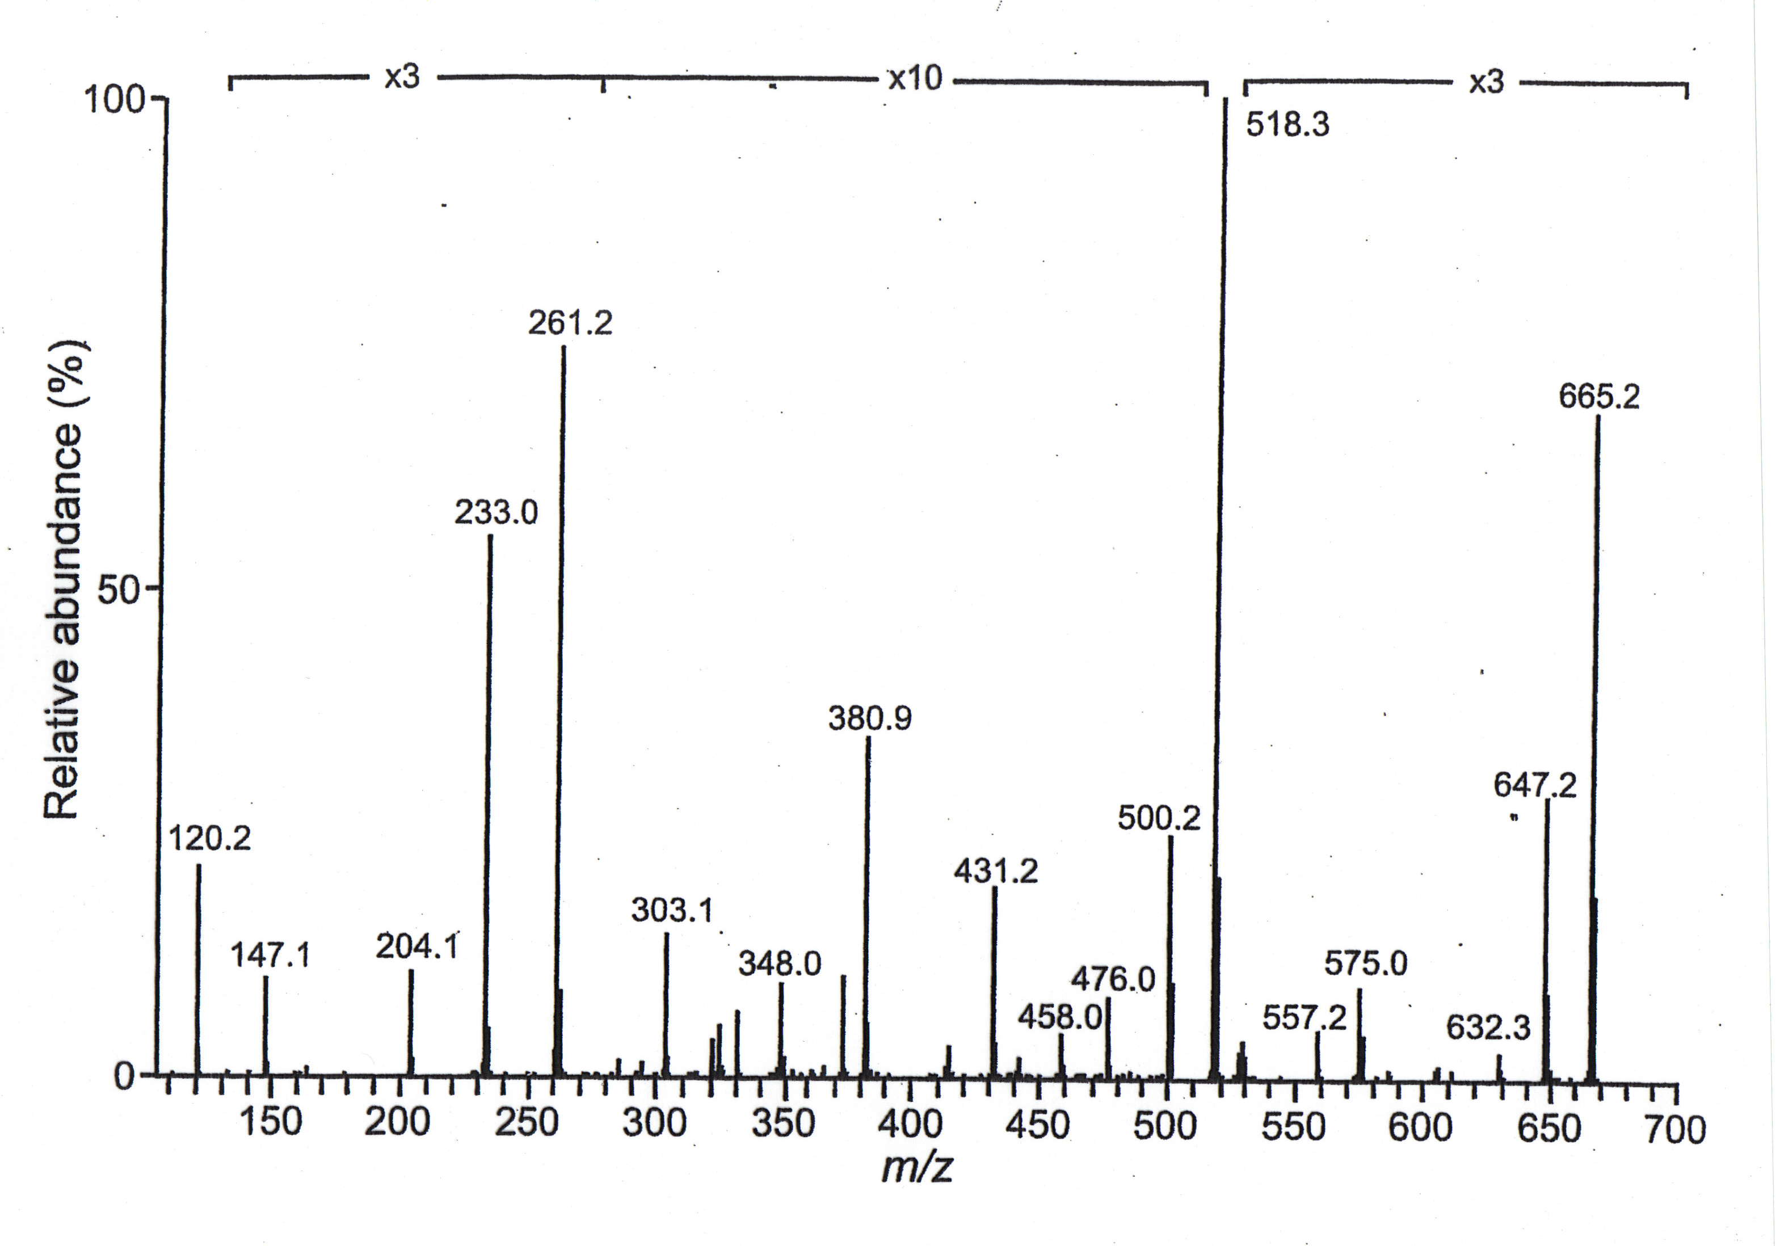
[M+H]⁺ = 778.6

Slide 16
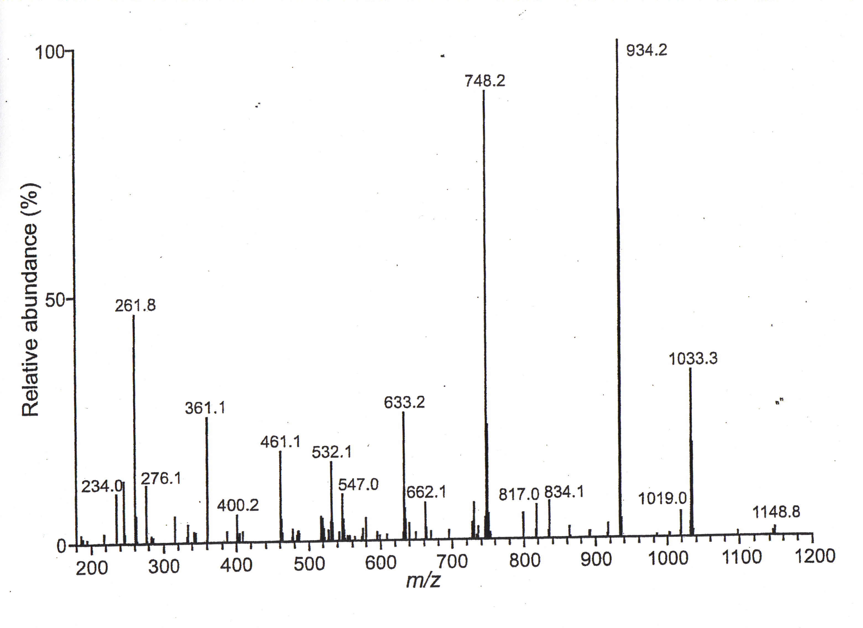
[M+H]⁺ = 1295.0

Slide 17
Shotgun Proteomics
Protein Mixture
MS/MS
1
2
3
3
proteolysis
2
µLC
MS
1
Peptide Mixture

Slide 18
Data Dependant Acquisition
No
Yes
Is Intensity > Threshold
Is Ion Present In Mass List
Full Scan 400-2000 m/z
Yes
No
Isolate m/z and Acquire MS/MS
Add Mass to Mass List
Yates et al. Anal Chem, 67, 1426 (1995)
Stahl et al. JASMS, 7, 532 (1996)

Slide 19

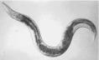
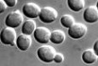
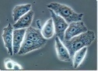
Can we perform this experiment without the separation of proteins?
Extract Protein Mixture
Model Organisms
cells in culture
Denature
Digest into Small Pieces

Slide 20
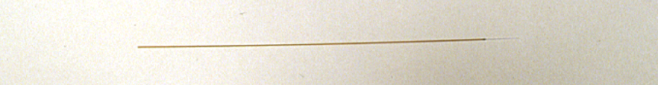
Measurement of Peptides by Microcapillary Liquid Chromatography Tandem Mass Spectrometry
Microcapillary Chromatography Column
Peptide Mixture
Peptides are loaded onto the column and separated by liquid chromatography
Abundance
Time

Slide 21
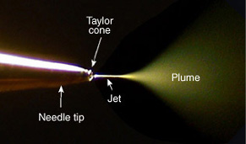
Acquiring Mass Spectrometry Data of Peptides
Microcapillary Column
2 kV
30 V
Peptides from the column are ionized and transmitted into the vacuum system using electrospray and trapped in the 2-dimensional ion trap

Slide 22
Acquiring Mass Spectrometry Data of Peptides
Peptides from the column are ionized and transmitted into the vacuum system using electrospray and trapped in the 2-dimensional ion trap
Ions are selectively ejected radially by their m/z to produce a mass spectrum
The instrument data-system automatically selects a m/z for further analysis
Selected m/z
Abundance
m/z

Slide 23
Acquiring a Fragmentation Spectrum
The trap is then refilled

Slide 24
Acquiring a Fragmentation Spectrum
The trap is then refilled
All ions are ejected from the trap except the predetermined m/z
The energy of the isolated ion is increased resulting in collisions with the helium gas in the trap

Slide 25
Acquiring a Fragmentation Spectrum
The collisions with the helium molecules result in structure specific fragment ions
The fragment ions are then selectively ejected to produce a tandem mass spectrum
Abundance
m/z

Slide 26
Review
Mass Spectrum
1
2
3
Tandem Mass Spectra of Peptides
~1 Second per cycle
Acquire mass spectrum
Select peptides for tandem mass spectrometry
Selectively isolate and fragment peptides.
Repeat for 3 different peptides

Slide 27
Automated Interpretation of MS/MS Spectra
MS/MS Spectrum
Cross Correlation (Sequest)
Theoretical MS/MS Spectra
Search Database for Precursor Mass
HTTLDEM
DTTEMIH
TMETIDH
Automated
Sequence and
Modification Identification
Eng et al. JASMS, 5, 976 (1994)

Slide 28
Spectrum Identification
SEQUEST
Peptide ID list
Scan1 0.7 EGSSDEEVP…
Scan1 0.3 TFAEILNPI…
Scan1 0.2 ARFDLNNHD…
-------------------
Scan2 0.5 EDEESIRAV…
Scan2 0.2 WLGDDCFMV…
Scan2 0.1 IDRAAWKAV…
-------------------
Scan3 0.2 EITTRDMGN…
Scan3 0.1 GRNMCTAKL…
MS/MS spectra
…
Computer Cluster
>MEKK1 (kinase)
MDRILARMKKSTRRGGDKNITPVRRLERR…
>ATMKK5 (kinase kinase)
MKPIQSPSGVASPMKNRLRKRPDLSPPLPHRDVALAVLP…
ID proteins from peptides…
Database: fasta file
Eng et al. JASMS, 5, 976 (1994)

Slide 29
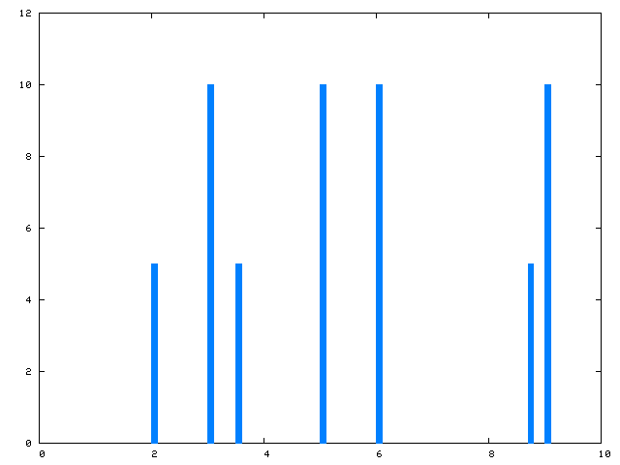
Spectrum Identification
SEQUEST
Peptide ID list
Scan1 0.7 EGSSDEEVP…
Scan1 0.3 TFAEILNPI…
Scan1 0.2 ARFDLNNHD…
-------------------
Scan2 0.5 EDEESIRAV…
Scan2 0.2 WLGDDCFMV…
Scan2 0.1 IDRAAWKAV…
-------------------
Scan3 0.2 EITTRDMGN…
Scan3 0.1 GRNMCTAKL…
z = 2, m/z = 720.6
mass = 1441.2
MS/MS spectra
score = 0.3
>MEKK1 (kinase)
MDRILARMKKSTRRGGDKNITPVRRLERR…
>ATMKK5 (kinase kinase)
MKPIQTFAEILNPITWRNRLRKRPDLSPPLPHRDVALAVP…
TFAEILNPITWR
Database: fasta file
Eng et al. JASMS, 5, 976 (1994)

Slide 30
